Slide 1
PC Based Diagnostics Tool
Team 74

Slide 2
Team 74
Faculty Advisor
  Dr. Tragoudas
Project Manager
  Joseph Lenox (CE)
Team
  Douglas Palmer (EE)
  Tiffany Gallops (CE)
  Wesley Tredinnick (EE)

Slide 3
Outline
Executive Summary
Discussion
  PC Based Modular Diagnostics Tool
  Literature Review
  Plan to Complete
Work Completed (?)
The Plan to Complete (?)
Resources Required

Slide 4
Executive Summary

Slide 5
Discussion
PC Based Modular Diagnostics Tool
  A device that will combine the abilities of a multimeter, oscilloscope, and a logic analyzer.

Slide 6
Overview

Slide 7
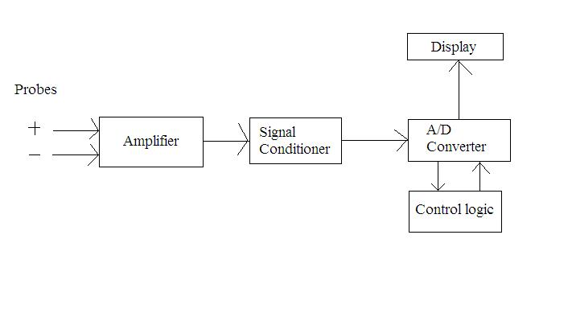
Multimeter subsystem
Will work in coordination with the oscilloscope and logic analyzer to acquire data
Will obtain data on the voltage, current, and resistance
Schematic design
will include
amplifier, ADC,
and control logic

Slide 8
Digital Oscilloscope
A device that measures voltage signals over time and presents it on a graph.
Uses
  Finding the time and voltage values of a signal
  Finding the frequency of a signal
  Debug circuit
  Decipher AC and DC parts of signal
  Find noise part of a signal

Slide 9
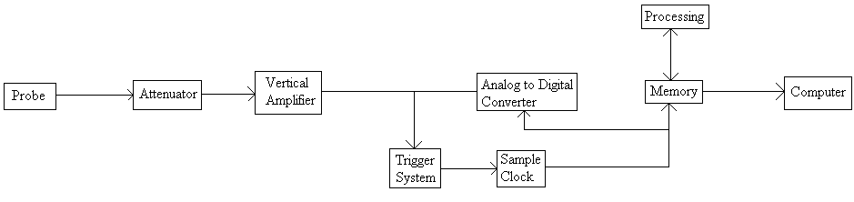
Digital Oscilloscope

Slide 10
Logic Analyzer
A device that finds the finds the stats of a digital circuit
Used to help debug digital circuit
Oscilloscope can be used for the same thing but a logic analyzer has many more channels so stats of different parts of the circuit can be viewed

Slide 11
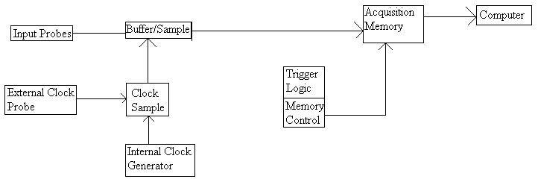
Logic Analyzer

Slide 12
Plan to Complete
R(esponsible)-A(pproval)-S(upport)-I(nformation)

Slide 13
Plan to Complete
Time Line
  Week 1: Final Component Decision
  Weeks 2 & 3: Complete Schematics
  Week 4: Complete Design Verifications
  Week 6: PCB's Ordered, Test and Develop Software
  Week 8: Software Complete
  Week 9: Begin Construction

Slide 14
Resources Required
LabVIEW
Bluetooth Stack Module (WRL-08461)
Analog/Digital Converters
Printed Circuit Boards
Miscellaneous Hardware
Projected Cost: Approx. $500 material cost

